Slide 1
Data publishing from the viewpoint of a biodiversity publisher
Lyubomir Penev, Vishwas Chavan, Gregor Hagedorn, Daniel Mietchen, Teodor Georgiev, David Roberts, Vincent Smith
TDWG Annual Meeting, New Orleans, 17-13 Oct 2011
ViBRANT

Slide 2
Life cycle of data associated with biodiversity manuscripts
Occurrence data
Any other data
Genome dada
Morphometric data
Biodiversity
manuscript
Phylogenetic data
Image galleries
Environmental data
XML MARK UP
Structured text (data!)
ARTICLES
Biblio- graphies
Occurr- ence data
Taxon treatments
Taxon names
Plazi
Wiki
COL
BHL

Slide 3
The Challenges
Biodiversity data highly diverse and heterogeneous
In most cases published as separate data files with poor metadata descriptions
Well established standards exist for only some types of biodiversity data : DarwinCore, Nexus, GenBank, Barcode of Life
Majority of published data not easily discoverable and citable, that is hardly usable
Lack of elaborated data citation mechanisms and citation tracking
Still unclear and sometimes confusing use licenses

Slide 4
But how to publish data then? What the authors are supposed to do to properly publish their data?

Slide 5
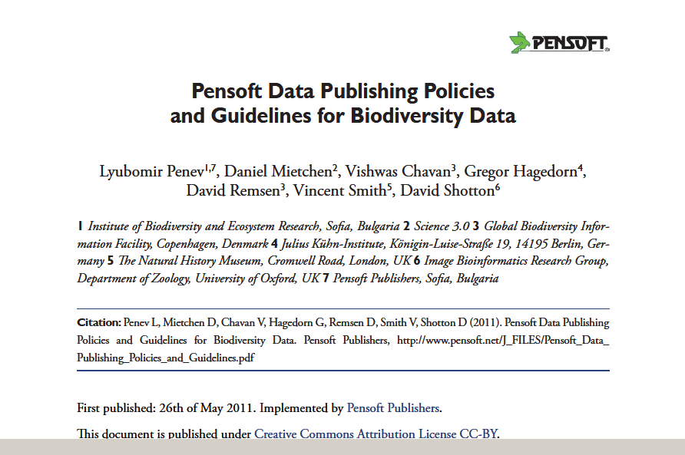
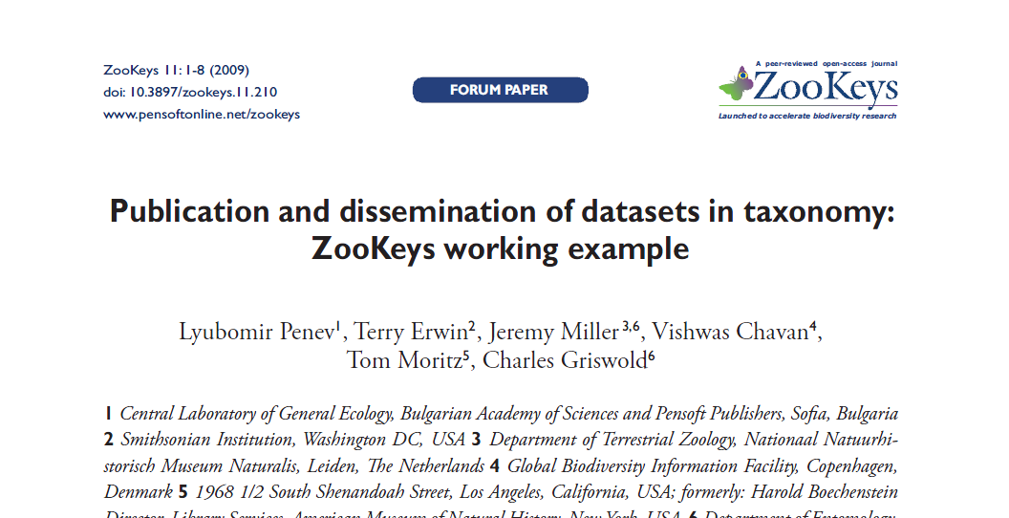

Slide 6
Multiple-Choice Data Publishing Model
Supplementary data files downloadable from the journals’ websites or elsewhere;
Data deposited as independent files at specialized data repositories and then linked to the journal article (e.g., Dryad, Pangaea);
Data published through data repositories but indexed and collated with other data (e.g., GenBank and GBIF IPT);
Data published in the form of marked-up, structured and machine-readable text.

Slide 7
The Dryad Data Publishing Model
Various kinds of data files associated with an article are deposited as a “data package” in one place
DataCite DOIs associated to each file and to the package as a whole
Data citation separated from the article citation
“Handshaking” mechanism is being elaborated with TreeBASE, GenBank, and others

Slide 8
Workflows (Dryad)
Manuscript SUBMISSION
Various data files
DataCiteDOIs
MANUSCRIPT ACCEPTED
Simple
metadata
Email metadata
Email author
Pre-link included
DataCiteDOIs
Various data files
MANUSCRIPT PUBLISHED
Data on Dryad available

Slide 9
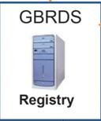
Workflows (GBIF IPT)
Occurrence data
Manuscript SUBMISSION
Extended metadata
MANUSCRIPT ACCEPTED
Persistent identifier
DOI
MANUSCRIPT PUBLISHED
Darwin Core Archive

Slide 10
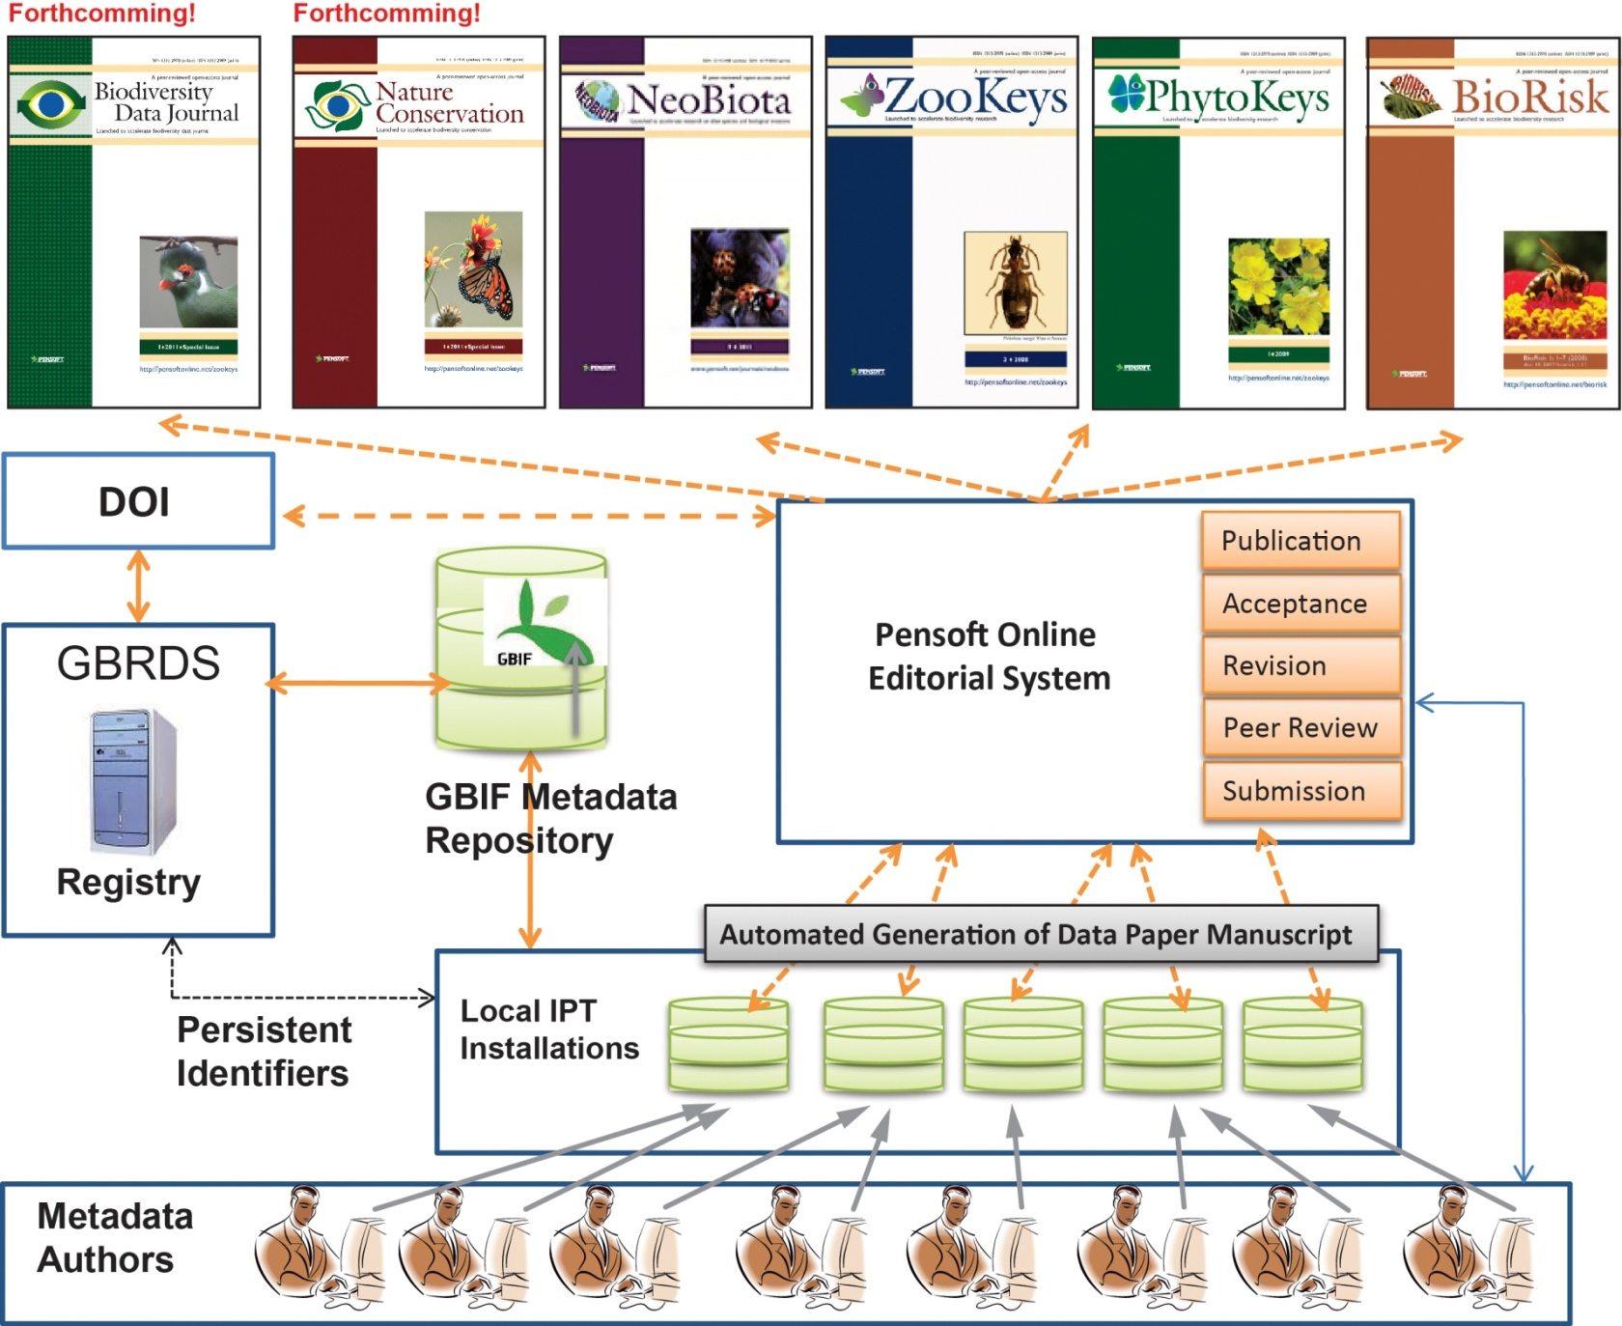
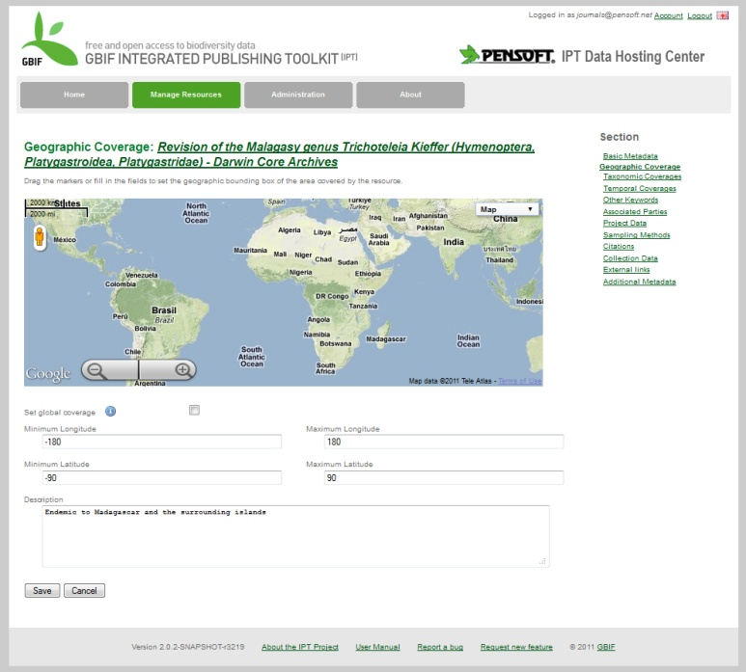
Occurrence datasets published as “data papers” through GBIF
IPT

Slide 11
The Future
ViBRANT
Virtual Biodiversity
Virtual Biodiversity Research and Access Network for Taxonomy" (ViBRANT) is a European Union FP7 funded project starting in December 2010 that will support the development of virtual research communities involved in biodiversity science. Our goal is to provide a more integrated and effective framework for those managing biodiversity data on the Web.

Slide 12
ViBRANT will provide
An automated, “press-a-button” submission of manuscripts, from Scratchpads and authors’ databases
An automated, “press-a-button” submission of data paper manuscripts, through XML, from the GBIF metdata catalogue – data publishing!
Launching of an open-access, “next generation”, Biodiversity Data Journal
Unification of mark up standards and output for data mining from legacy literature and prospective publishing

Slide 13
Thank you for your attention! Thank you…
ViBRANT

